Slide 1

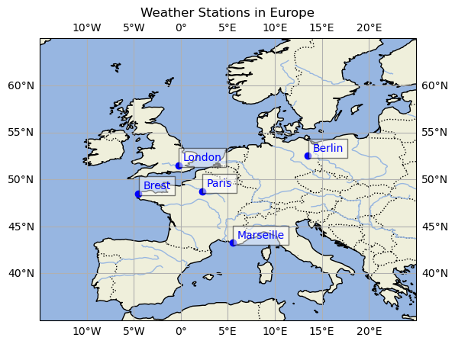
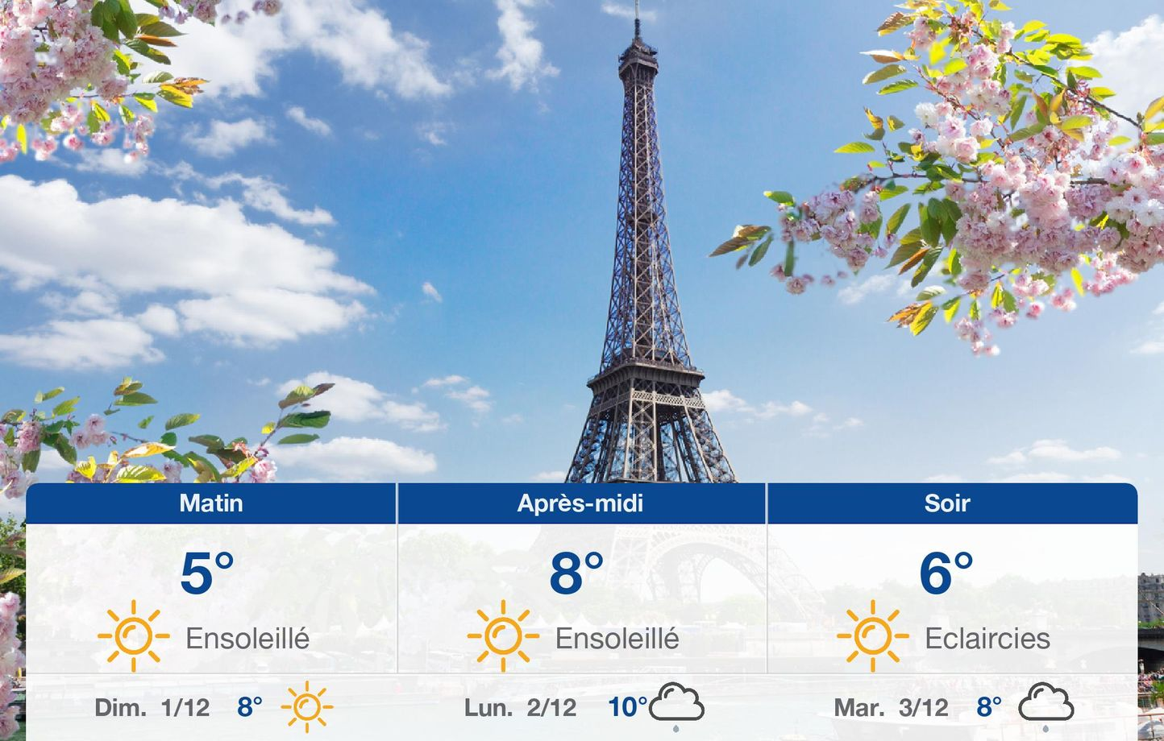
ML for climate and Energy (MEC51057)
Weather station 2024-2025
Mentor: Julio Cardenas
Students: Dimitri Iratchet - Fabien Lagnieu - Tristan Waddington

Slide 2
ML for climate and Energy (MEC51057)
I. Project presentation
1.1 General presentation
Aim of the project :
Paris weather station was cyber-hacked, and is therefore unable to share its weather measures since the beginning of 2019.
Our task is to predict this missing data from other European weather stations measures.

Slide 3
ML for climate and Energy (MEC51057)
I. Project presentation
1.2 Data files presentation
We are given the raw measurements of 5 weather stations in separate files, split by station and by feature.
Each « .nc » file can be loaded with the « xarray » module in a specific format.
-> To facilitate the following study, this files are merged onto « Pandas » Dataframe.
Treatment:
Given the physicial differences in the meaning and scale of each feature, we decided to normalize the dataset by feature to use them in a machine learning process. But to be able to interpret back the results of our models, the inverse transformation should be available. That's why we specifically return the scalers during the loading process.
Signification: Each of the 10 features represent a physical measurement that is studied in the next part.

Slide 4
ML for climate and Energy (MEC51057)
II. Data Loading / preparation / study
2.4 Creation of the final dataset
To speed up the computational cost, we reduced the size of the dataset to a daily sample, with normalized data.
We kept only the 13 last years:
train: 70% 2007-2015,
test: 23% 2016-2018,
validation: 7 % 2019
Then, all datasets have been merged in a single DataFrame gathering all variables for all cities but Paris, that is the target.
Ultimately, for deep learning models, add the data of the 3 previous days to detect unlinear patterns.

Slide 5
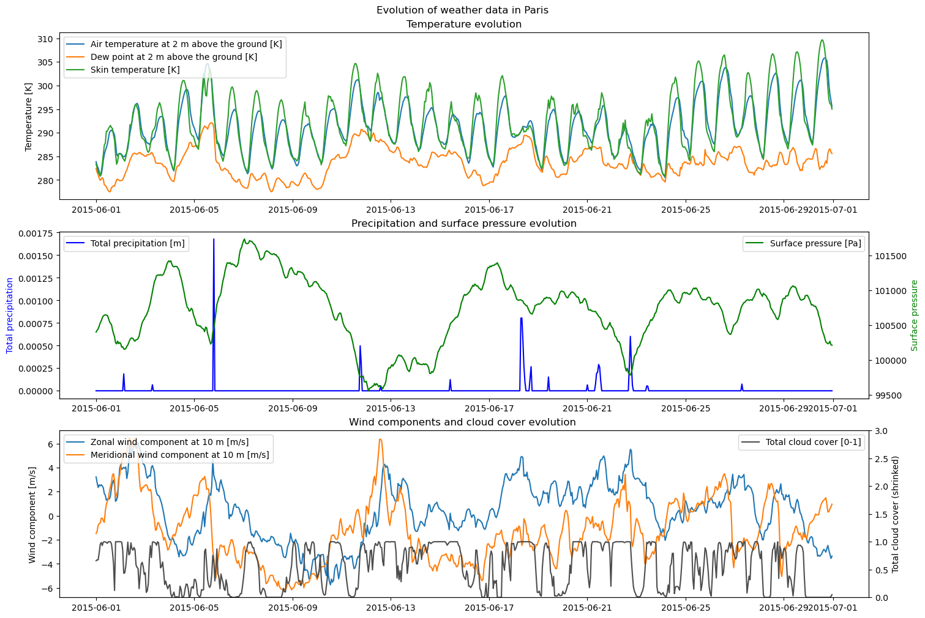
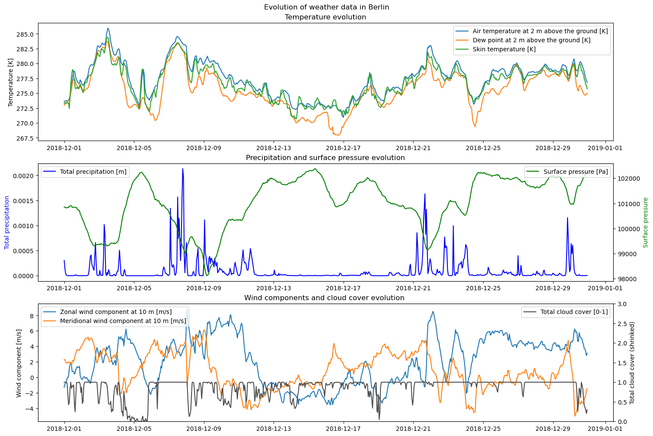
ML for climate and Energy (MEC51057)
II. Data Loading / preparation / study
2.1 Data exploration

Slide 6
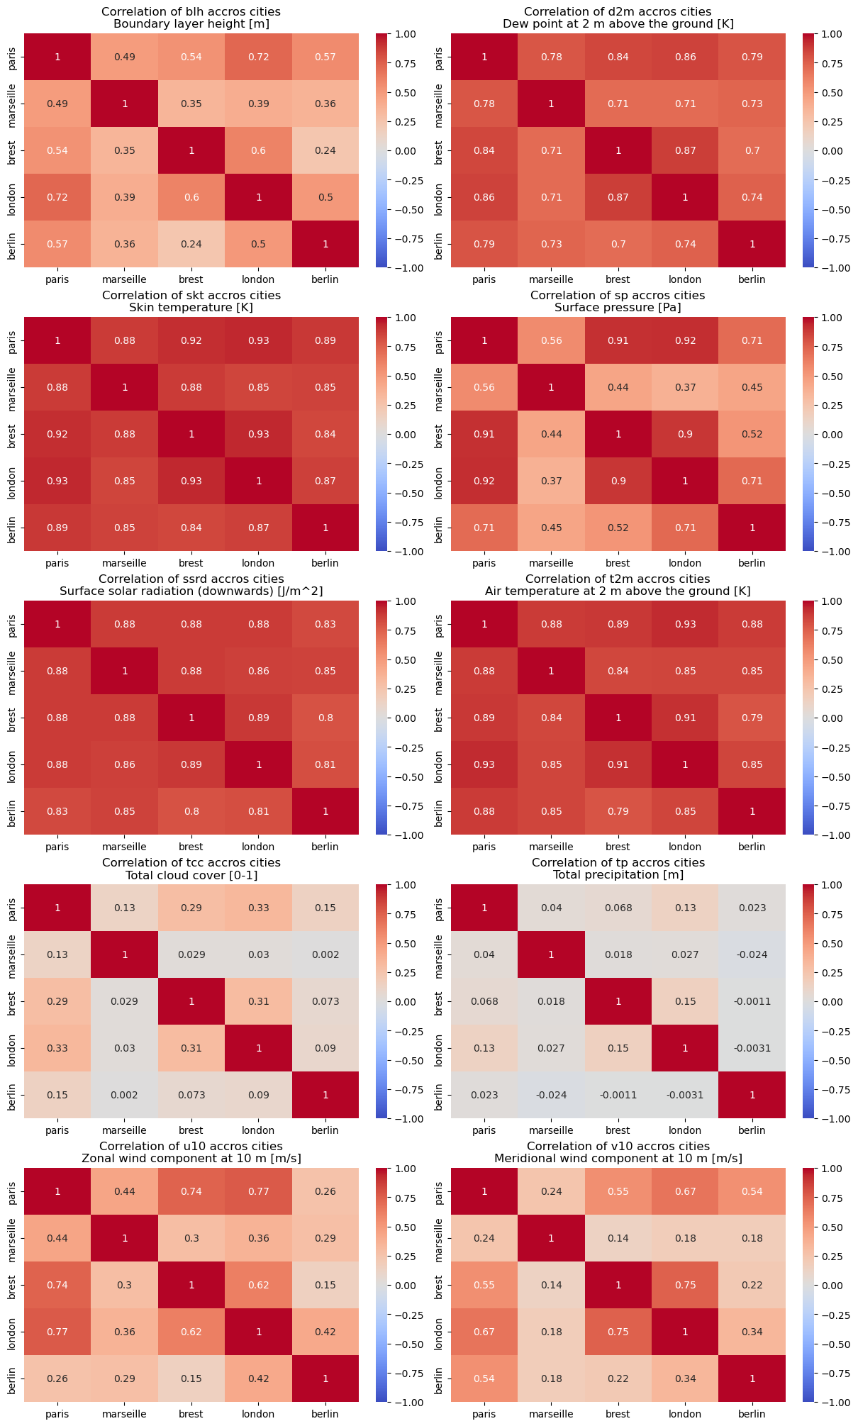
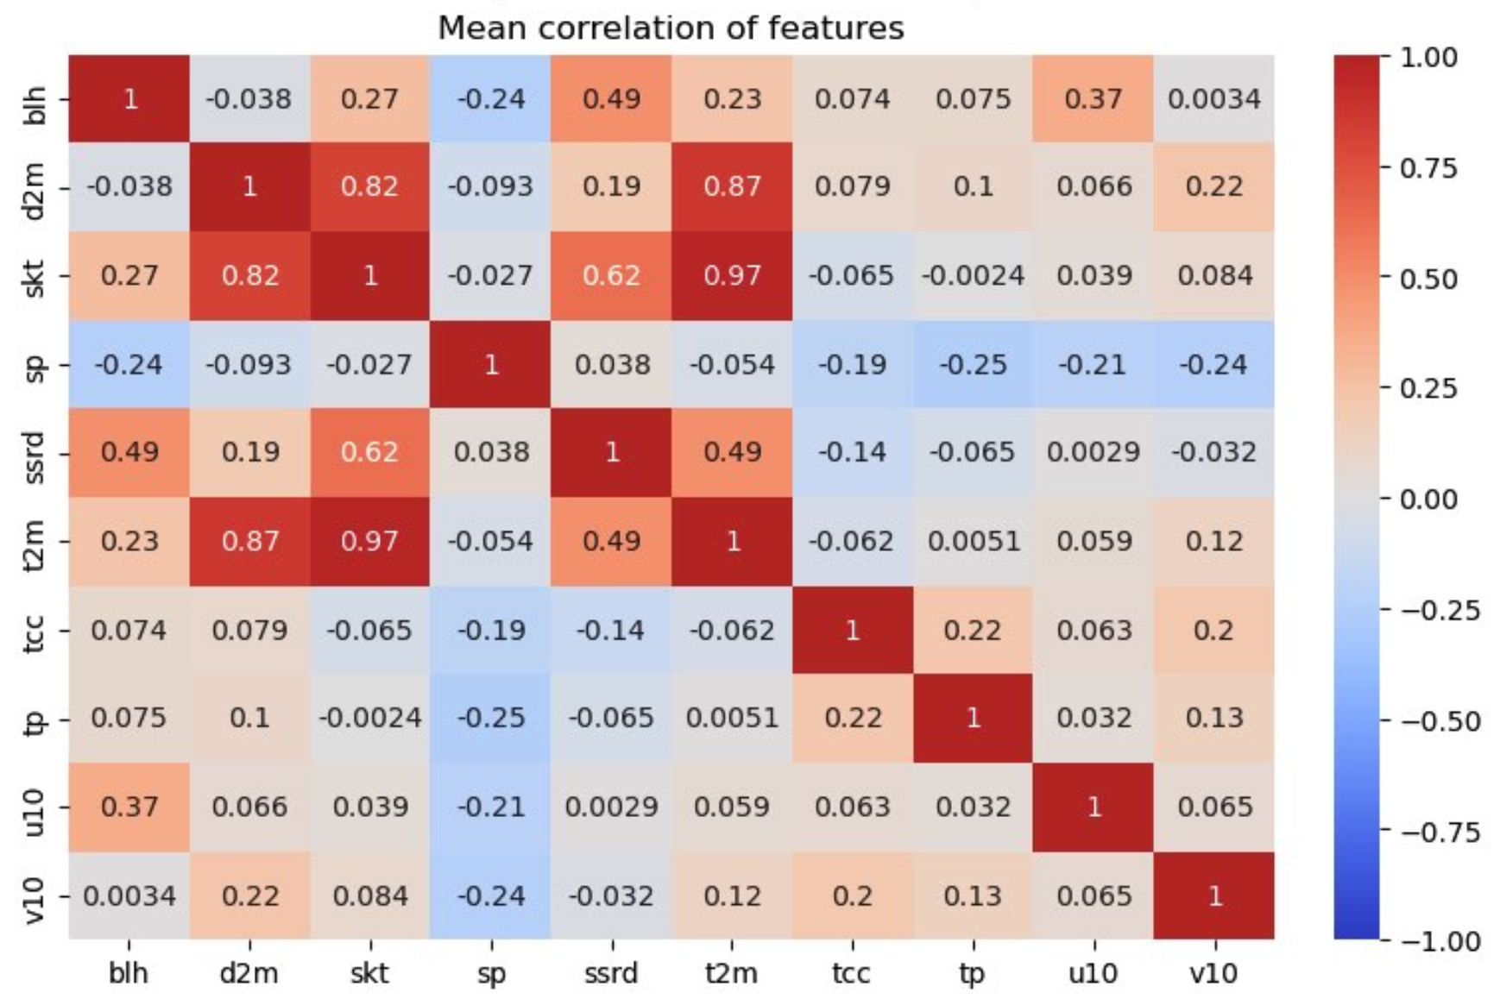
ML for climate and Energy (MEC51057)
II. Data Loading / preparation / study
2.2 Covariance study
—> Between Features
—> Between Cities

Slide 7
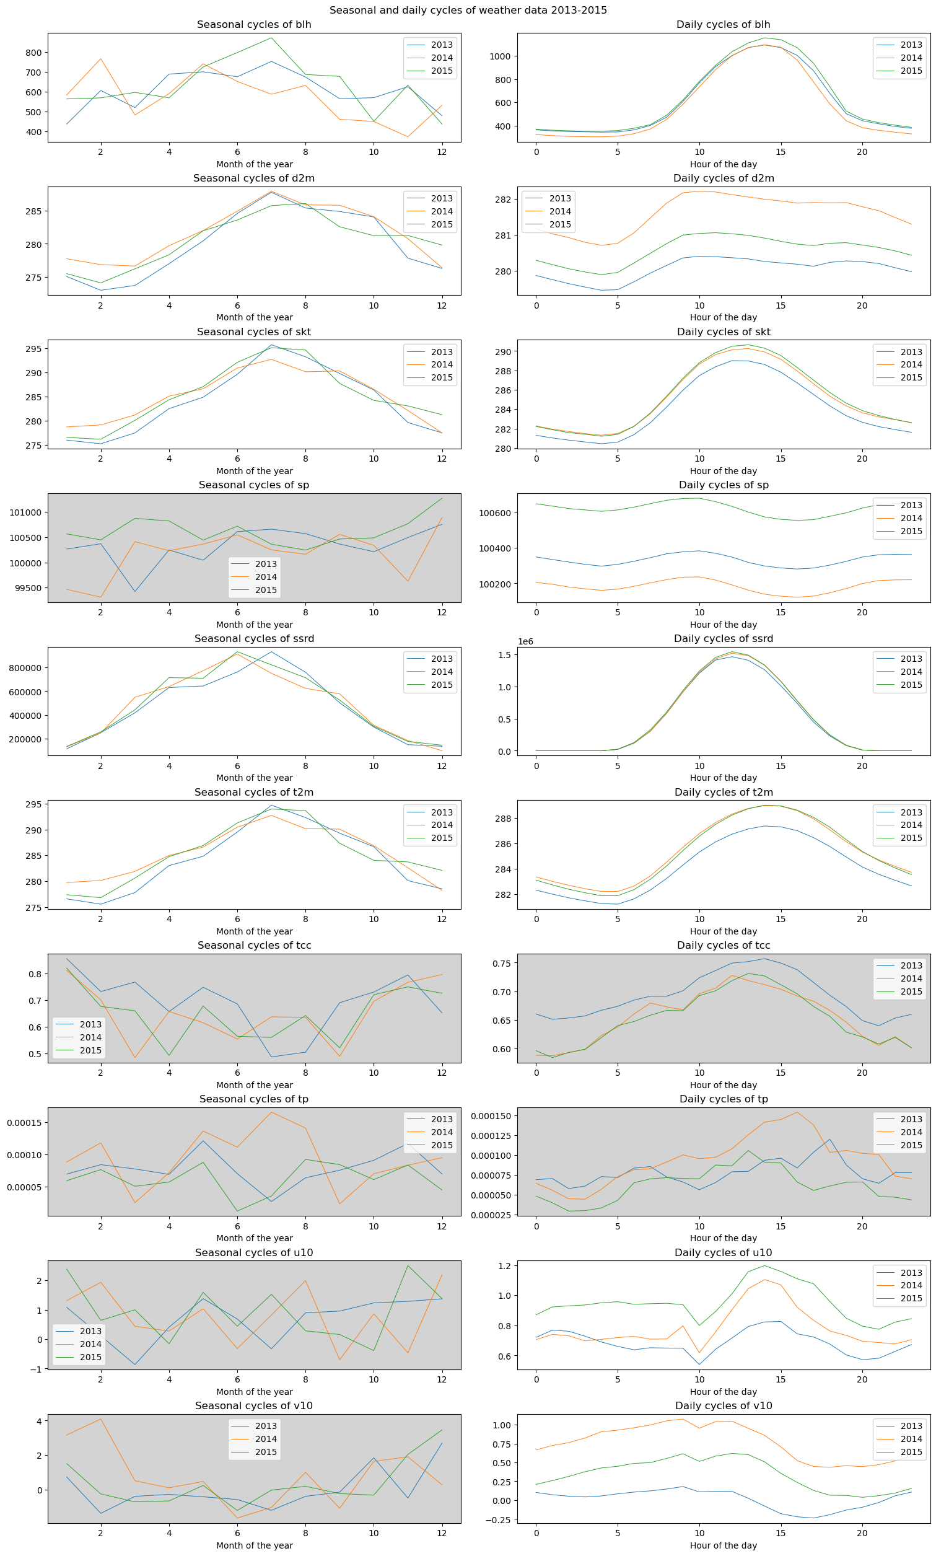
ML for climate and Energy (MEC51057)
II. Data Loading / preparation / study
2.3 Cycles in features

Slide 8
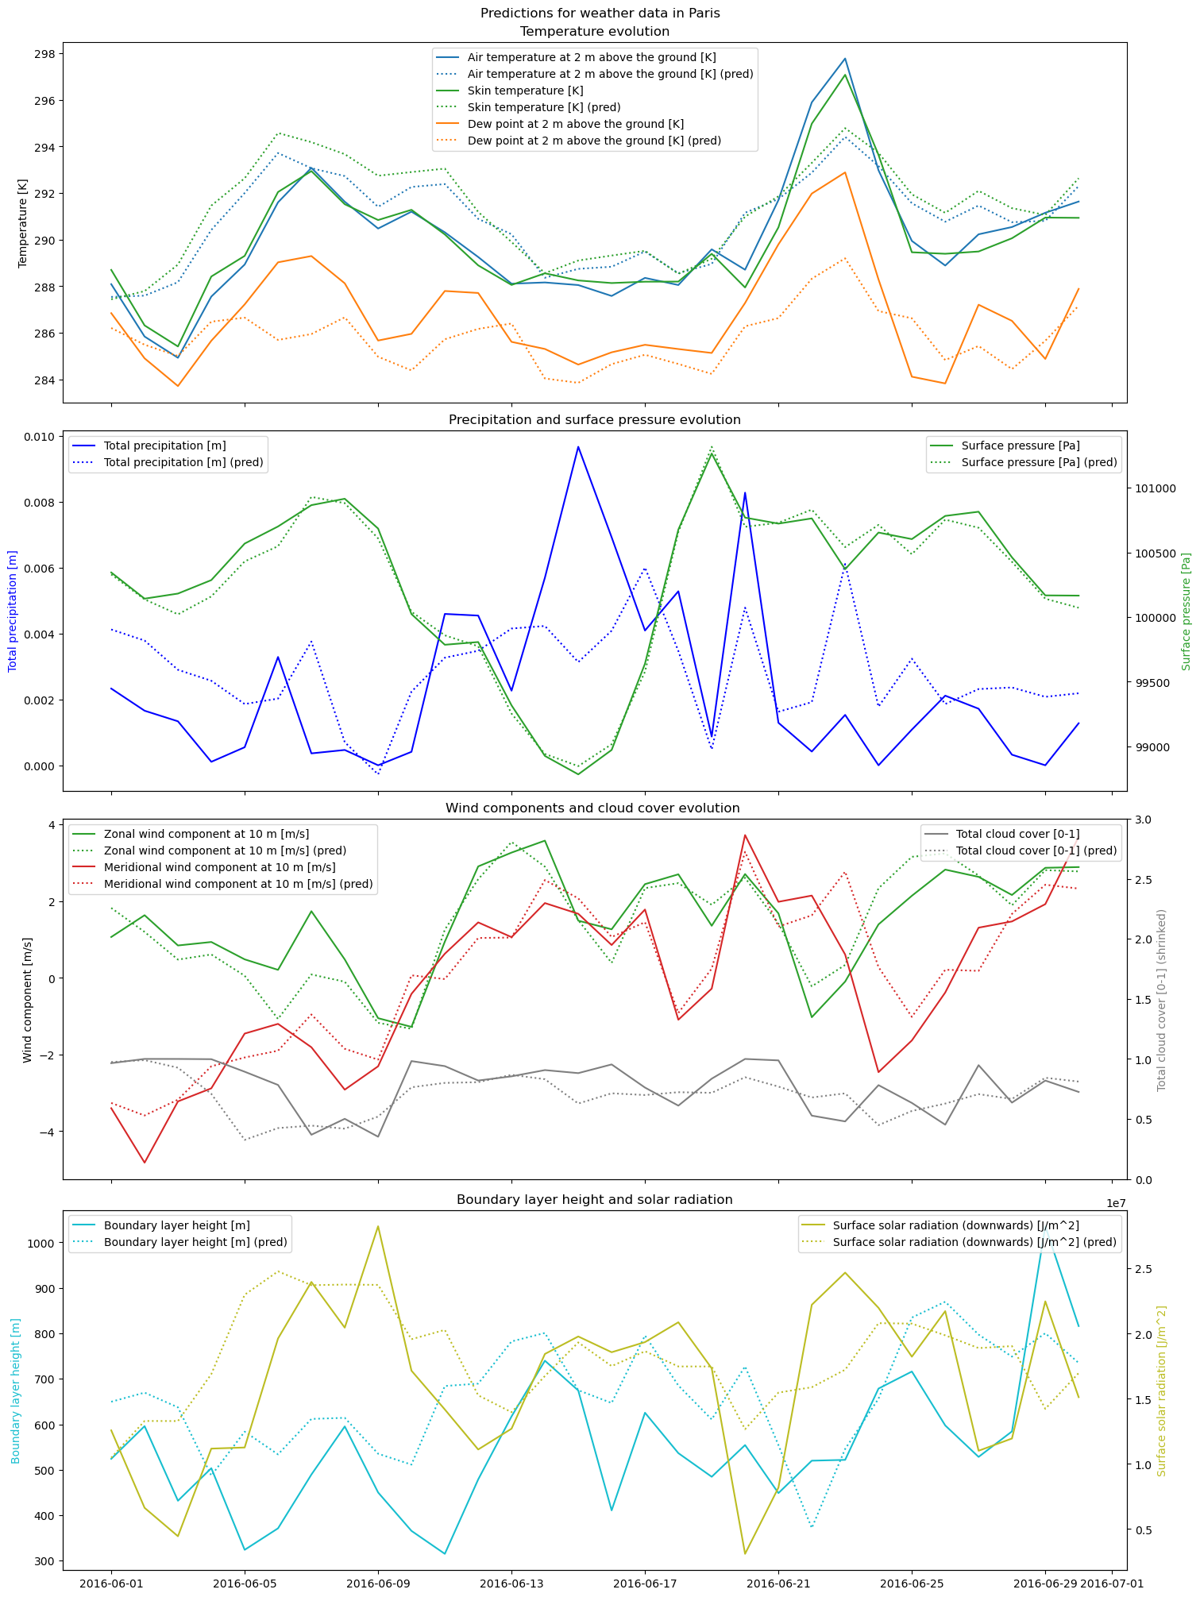
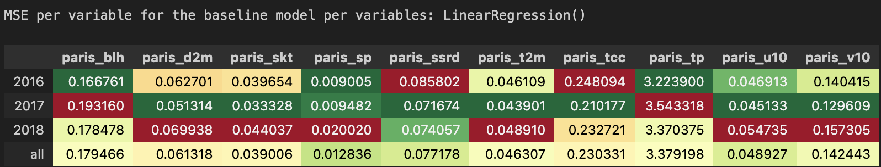
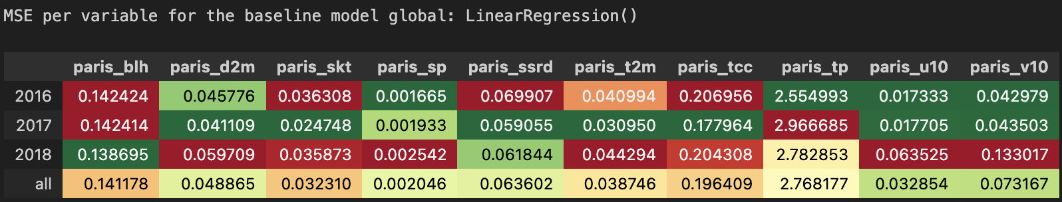
ML for climate and Energy (MEC51057)
III. Prediction of Paris Weather
3.0 Baseline : Linear regressor
Do we have different result when focusing only on one feature or are we more accurate when using all available features of the dataset?
In the following colored-gradients, we are expecting to have the most dark green / low value cells.

Slide 9
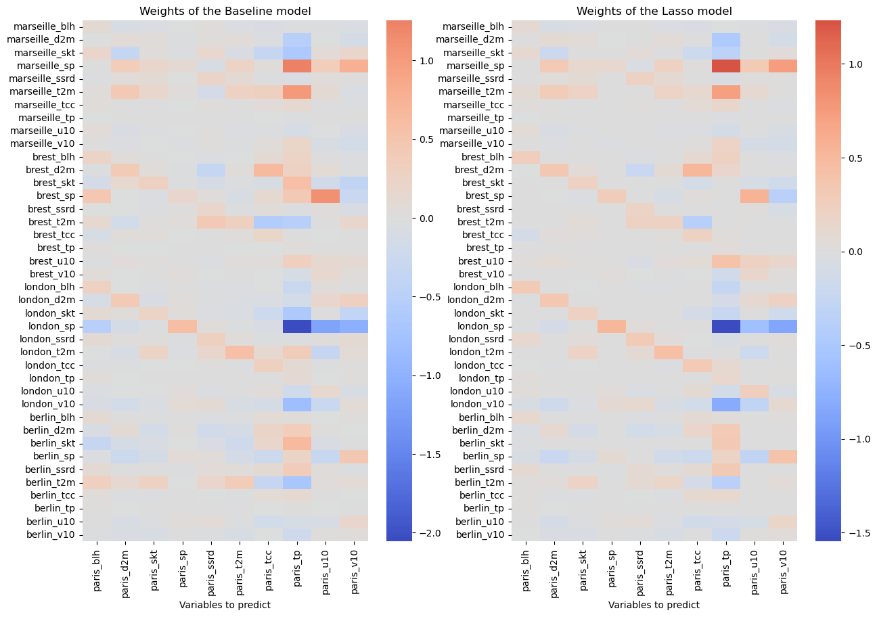
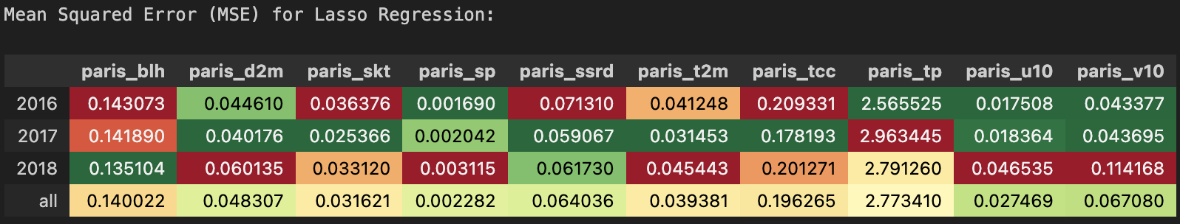
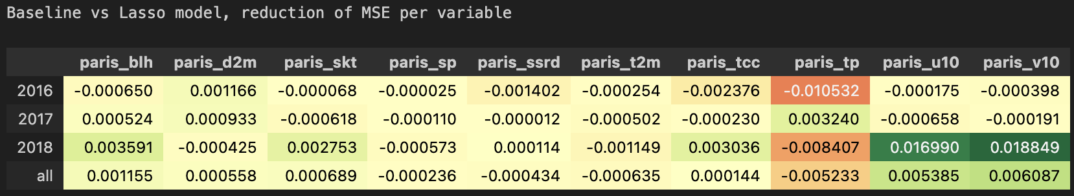
ML for climate and Energy (MEC51057)
III. Prediction of Paris Weather
3.1 Testing models
Linear Lasso

Slide 10
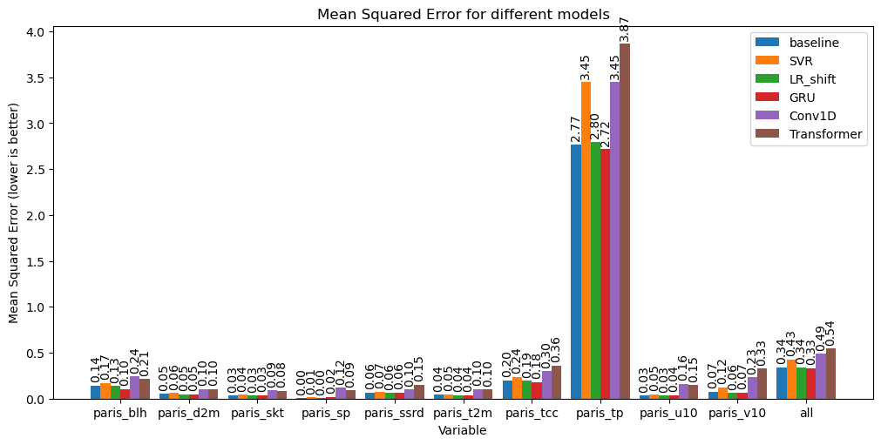
ML for climate and Energy (MEC51057)
III. Prediction of Paris Weather
3.1 Testing models
Tree-based models :
RandomForestRegressor
XGBoost
SVR
Deep learning :
GRU
CONV1D
Transformer

Slide 11
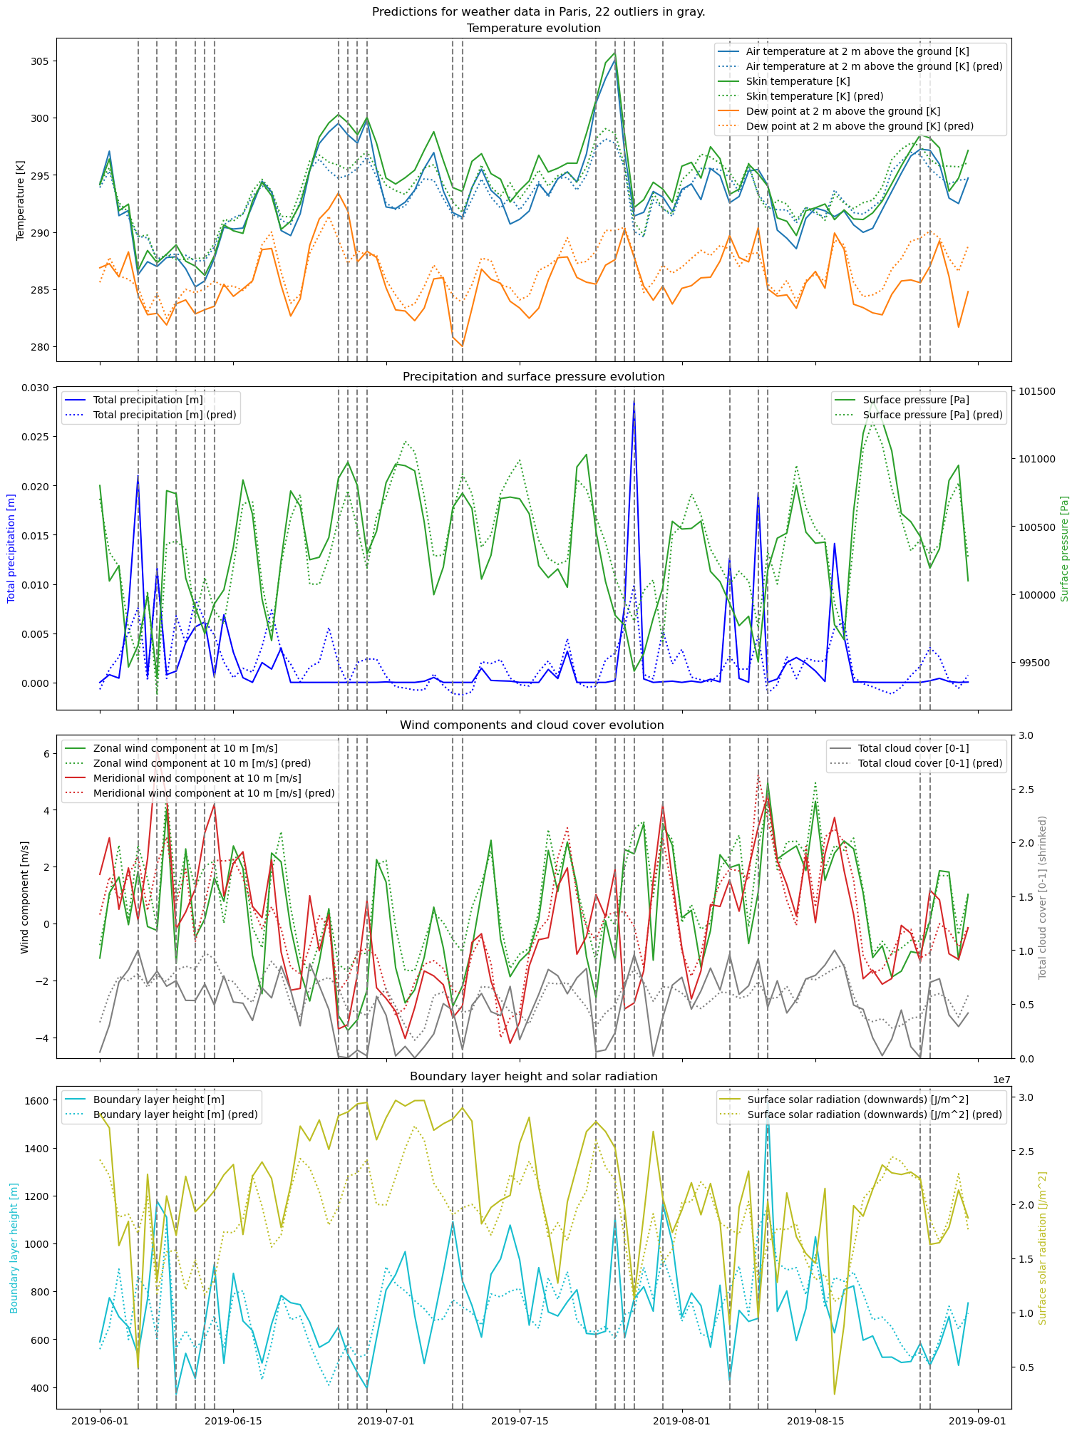
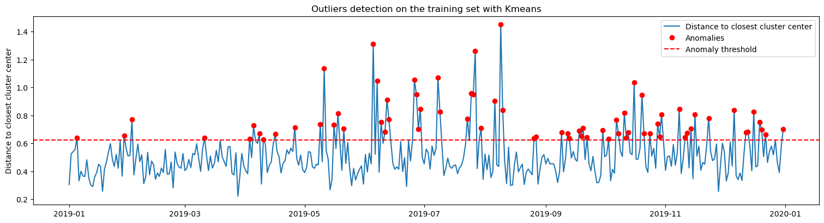
ML for climate and Energy (MEC51057)
IV. Anomaly Detection
Asumption 2016-2018: 1 cyber-incident / year with Paris reports
Detect anomalies between predictions and reports:
Best predictor= average of the 3 best models
With Kmeans --> 72 anomalies in 2019
With IsolationForest --> 1 anomaly in 2019
But represent extrema in weather reports ==> no cyber hack.

Slide 12
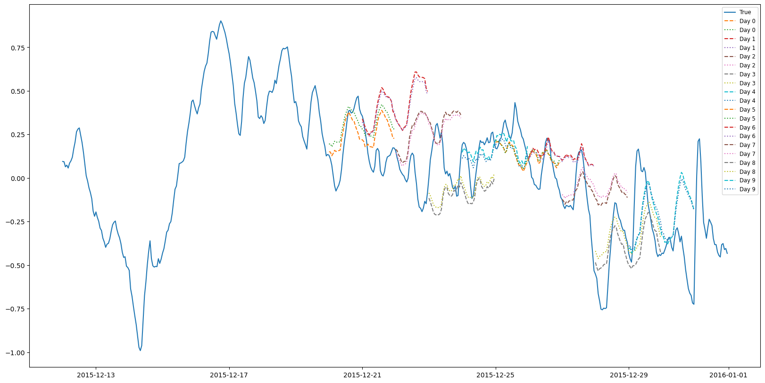
ML for climate and Energy (MEC51057)
Conclusion
Ambitious project: Supervsied Regression + Unsupervised Classification
==> we did it !
To go further :
times series with hourly data
simulate a datastream with modified data

